Slide 1
Answers to the people’s objections
Seminar 7

Slide 2
1. I cannot leave my church
Yohane 10:26, 27
Chibvumbulutso 18:4
Yohane 12: 42, 43

Slide 3
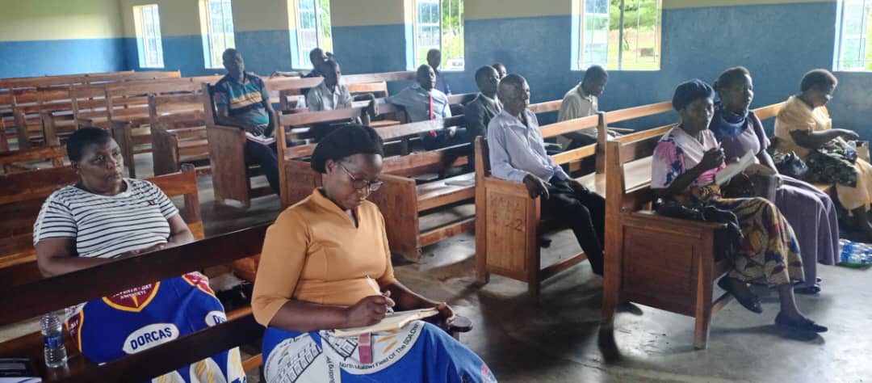

Slide 4
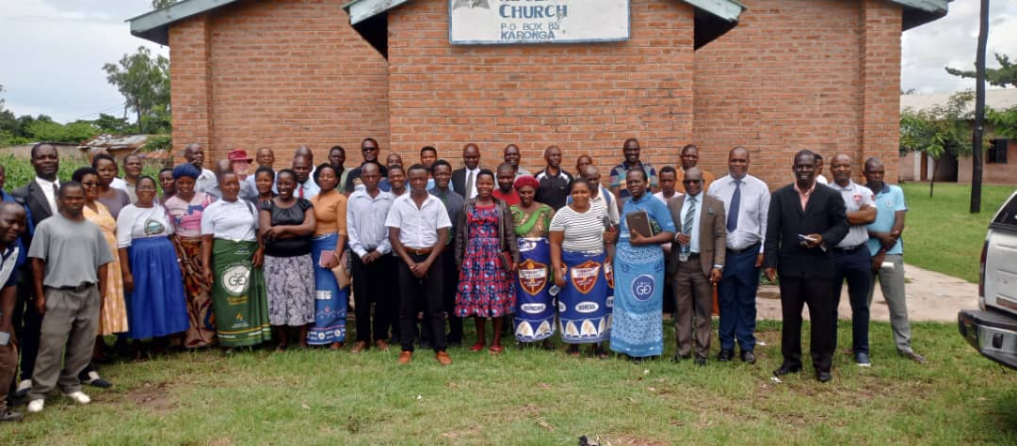

Slide 5
2. I cannot live if I can keep the sabbath
Mateyu 6:33
Masalmo 37:3
Yesaya 65:13, 14.

Slide 6
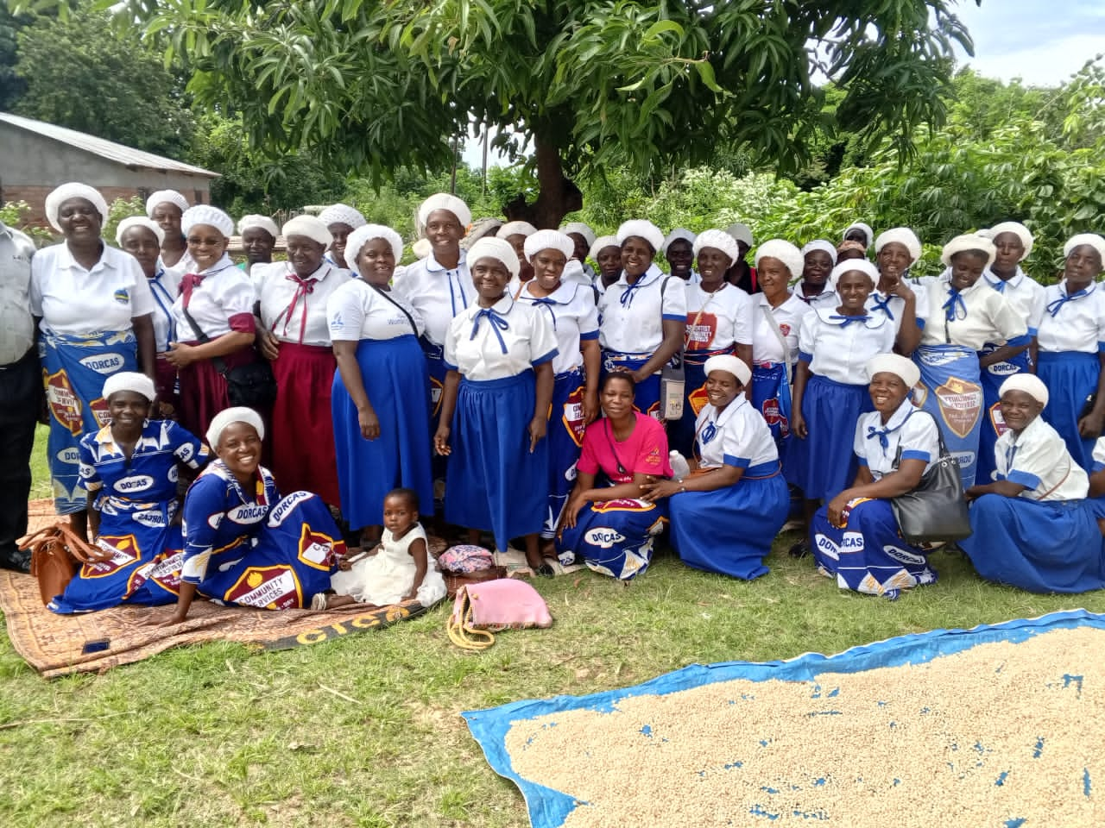

Slide 7
3. I can lose my job if I keep the sabbath or follow this truth
Mateyu 16:25, 26
I Timoteo 4:8, 9
Masalmo 119:119,127
Yesaya 51:7.

Slide 8
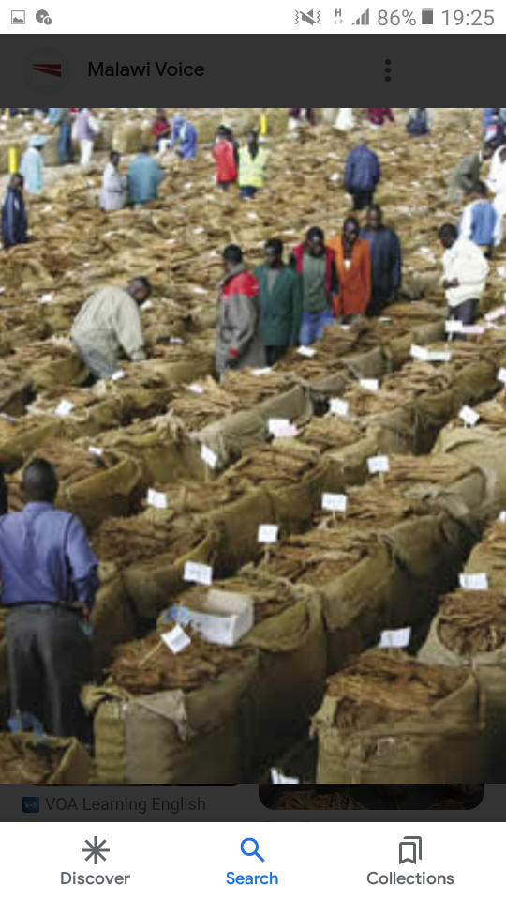

Slide 9
4. It is hard to keep the seventh-day and follow this truth
Mateyu 16:24
Mateyu 10:38.

Slide 10
5. I am a great sinner
Luka 19:10
Yesaya 1:18
I Timoteo 1:15
Aheberi 7:25.

Slide 11
6. I have got fear
Yesaya 41:10, 11
Deuteronomo 31:6, 8.

Slide 12

Mantha ndi atsogoleri a mpingo
Mantha ndi makolo

Slide 13
7. I cant follow this truth
1 Akorinte 10:14, 15
2 Akorinte 12:8, 9
Yohani 1:12.

Slide 14
8. I am not good enough
2 Akorinte 8:12
Chibvumbulutso 3:8.

Slide 15
9. People will speak of me
Yohane 17: 14
Luka 6: 22, 23
Miyambo 29:25, 26.

Slide 16
10. My friends shall lough at me
Yohane 15: 19
Marko 8:34
Yakobo 4:4.

Slide 17
11. My father, mother, sisters, and relatives can oppose me
Mateyu 10:36, 37
Luka 14:26-27
Masalmo 27:10.

Slide 18
12. My leaders disallow me
Machitidwe 4:19
Machitidwe 5:29
Yoswa 24:15
1 Atesalonika 4:7, 8.

Slide 19
13. There is one thing I fail to leave it (beer, tobacco etc)
Mateyu 19:20-22
Mateyu 6:24
Luka 14:33.

Slide 20
14. As for today no, may be in the future
Miyambo 27:1
2 Akorinte 6:2
Aheberi 3:13
Yesaya 55:6
Genesis 6:3.

Slide 21
15. I wait for my husband or my wife that we should start together
Ezekieli 14:20
Ezekieli 18:20, 21
Aroma 14:12.

Slide 22
16. You are late I waited for a long time
Ezekieli 33:19
Yohane 6:37
Aroma 10:13.

Slide 23
17. I tried at first to follow this truth but I failed
2 Timoteo 1:12
Aroma 4:21
Yeremiya 8:4-6.

Slide 24
18. How can I know that my sins have been forgiven?
1 Yohane 1:8,9
Miyambo 28:13.

Slide 25
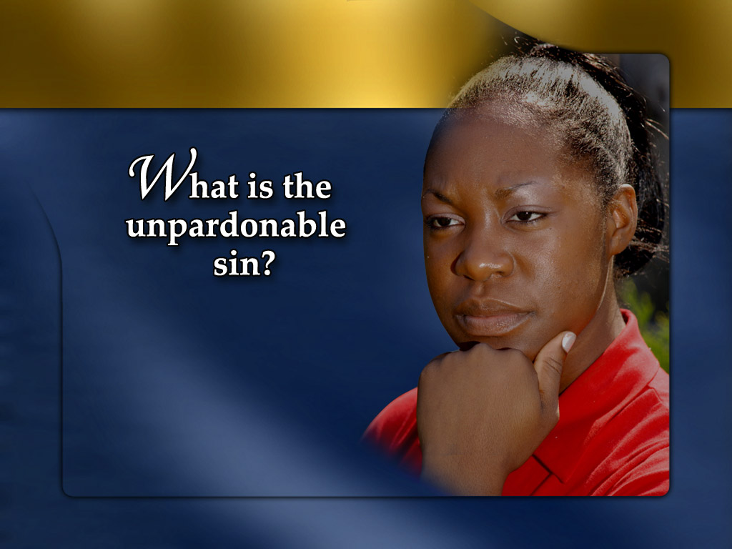
NDINGADZIWE BWANJI KUTI MACHIMO ANGA AKHULULUKIDWA?

Slide 26
19. I am atleast better
Yohane 3:18
Aroma 3: 10, 23.

Slide 27
20. God is love we shall be saved
Luka 13:3-5
2 Petro 2:4-6.

Slide 28
21. There are too many hypocrites in the church I cannot enter
Mateyu 7:1-5
Aroma 14:12.

Slide 29
22. I cannot leave my friends and my relatives
Eksodo 23:2
Luka 14:26, 27

Slide 30
23. It is not good to enter the church because to be a christian is your heart
Machitidwe 2:46, 47. “Ndipo tsiku ndi tsiku anali cikhalire ndi mtima umodzi m’Kacisi, ndipo ananyema mkate kunyumba kwao, nalandira cakudya ndi msangalalo, ndi mtima woona; 47 nalemekeza Mulungu ndi kukhala naco cisomo ndi anthu onse. Ndipo Ambuye anawawonjezera tsiku ndi tsiku akuti apulumutsidwe.

Slide 31
24. I am too old to change my life
Genesis 12:1, 4 “Ndipo Abramu anali wa zaka makumi asanu ndi awiri kudza zisanu pamene anaturuka m’Harana.” (75)

Slide 32
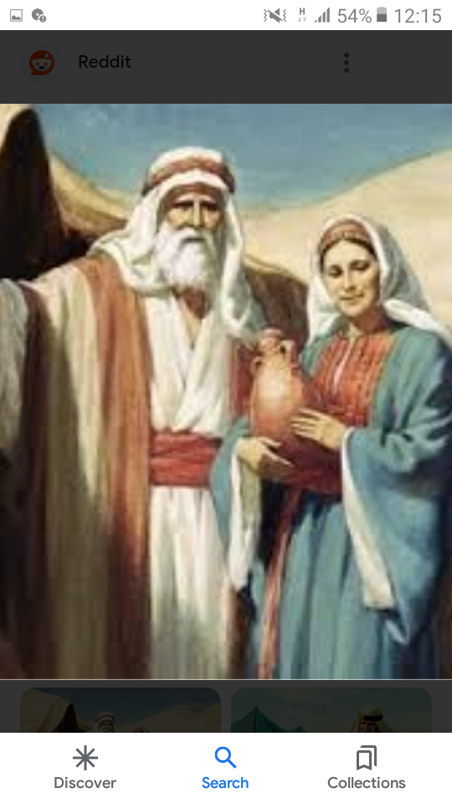
Abrahamu
Sarai

Slide 33
25. I will wait until the Holy Spirit falls upon me and is when I will follow the truth
Mateyu 25:1-13. Anamwali asanu opusa analephera kulandira mkwati chifukwa cha kuchedwa.

Slide 34
26. I can leave so many things if I follow this truth
Luke 14:33
Philip 3: 7,8
Mlaliki 11:9
Mateyu 6:24.

Slide 35
27. I cannot manage to follow this truth
Yohane 1:12
1 Petro 5:10
Afilipi 1:6.

Slide 36
28. Your church has few people I cannot enter
Mateyu 22:14
Mateyu 7:13,14
Eksodo 23:2

Slide 38
29. There is no difference between Saturday and Sunday
Ezekieli 22:26
Levitiko 10:10.

Slide 39
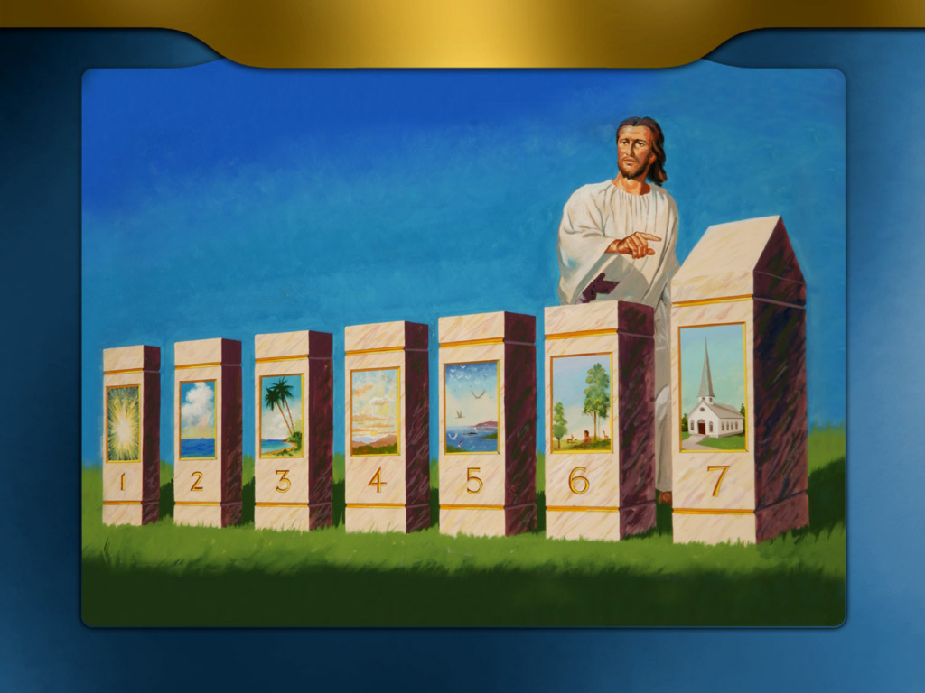
Zuwa la chinkhonde na chiwiri
Wakalirongora yekha

Slide 40
1 Yohane 2:4,6 “Iye wakunena kuti, Ndimudziwa Iye, koma wosasunga malamulo ace, ali wabodza, ndipo mwa iye mulibe coonadi; iye wakunena kuti akhala mwa Iye, ayeneranso mwini wace kuyenda monga anayenda Iyeyu.”

Slide 41
30. Are you telling me that God will destroy all Sunday keepers, this can’t happen.
Acts 17:30
Psalm 73:27,28

Slide 42
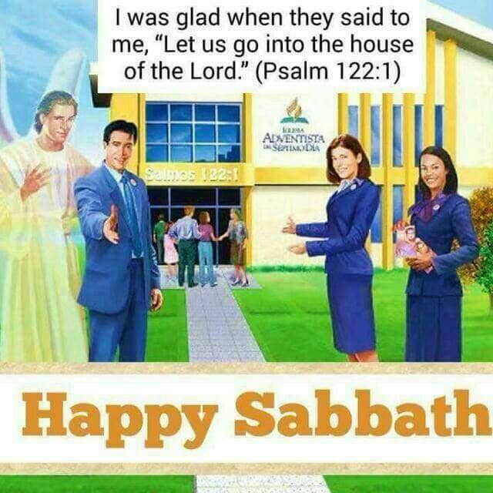
Khalani wokondwa popembedza Mulungu

Slide 43
Ndingadziwe bwanji kuti machimo anga akhululukidwa?
Khalani okonzeka kuyankha zokanila za anthu 1 Petro 3:15
The end

